Slide 1
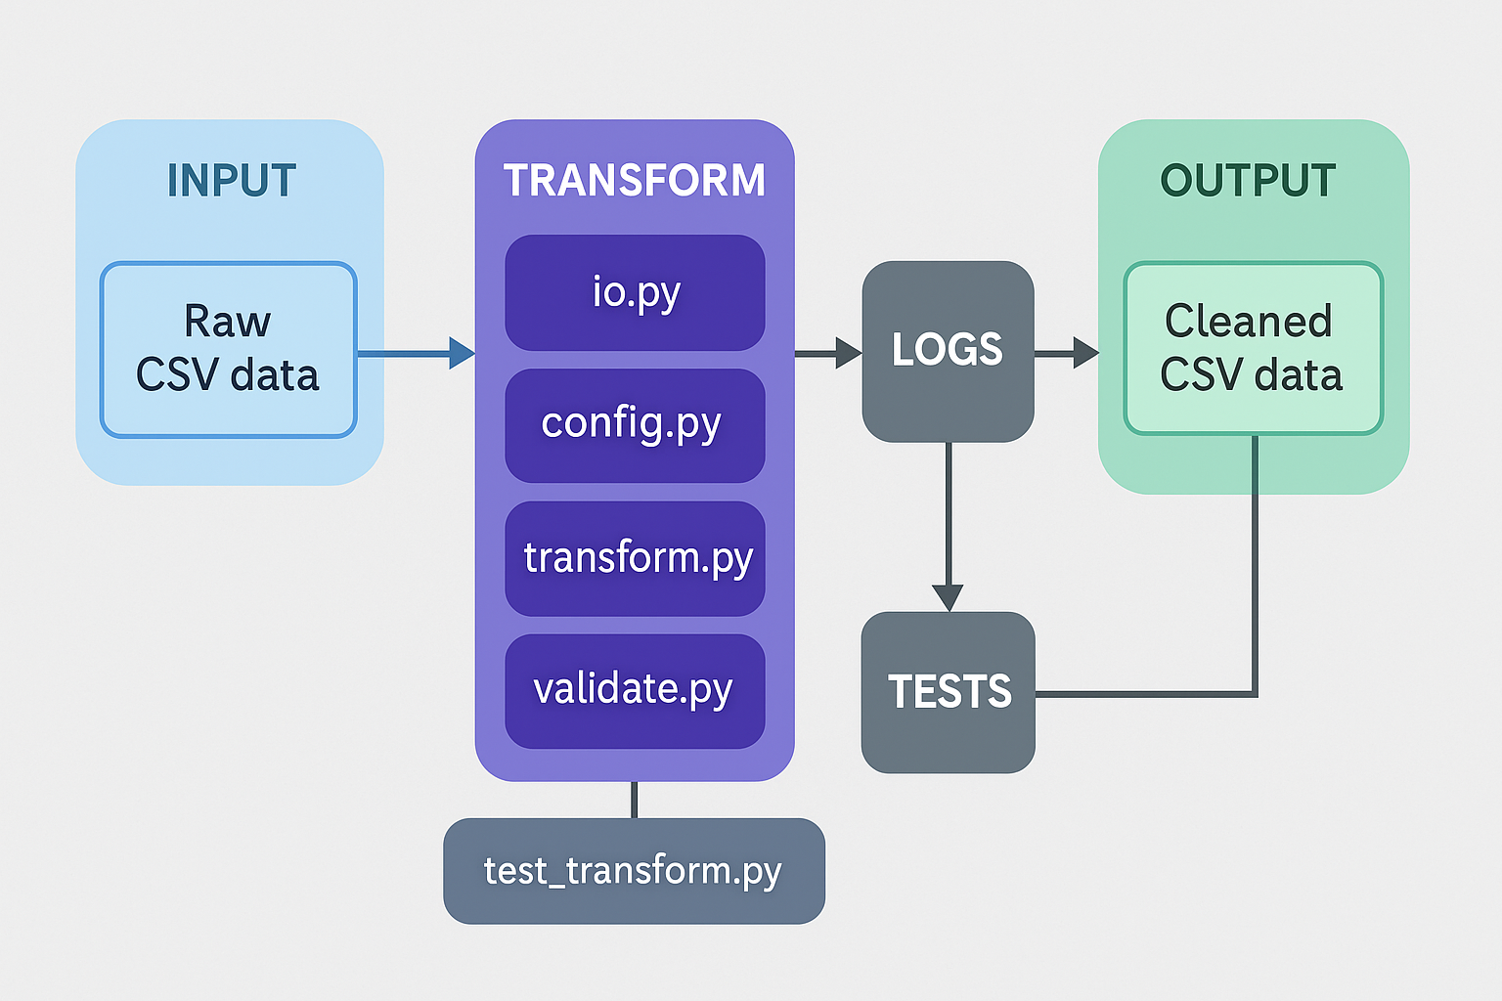
Data Flow Structure

Slide 2
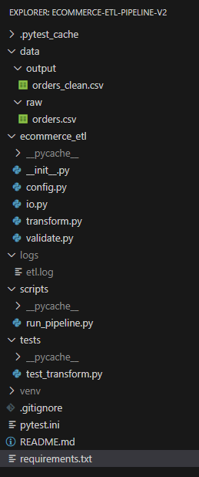
Folders Structure

Slide 3
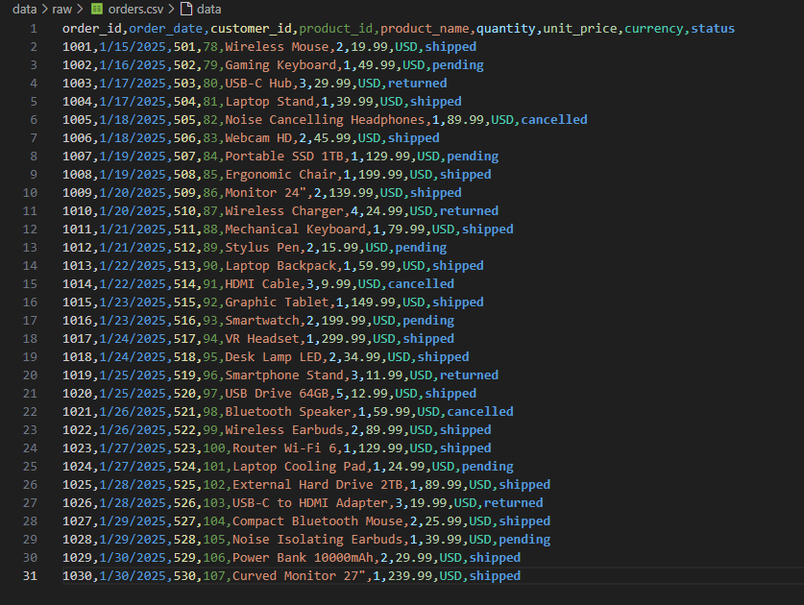
Data Raw

Slide 4
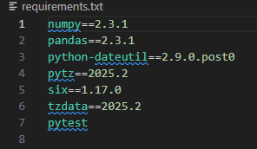
Requirements.txt

Slide 5
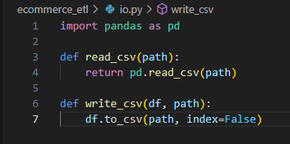
Io.py

Slide 6

Config.py

Slide 7
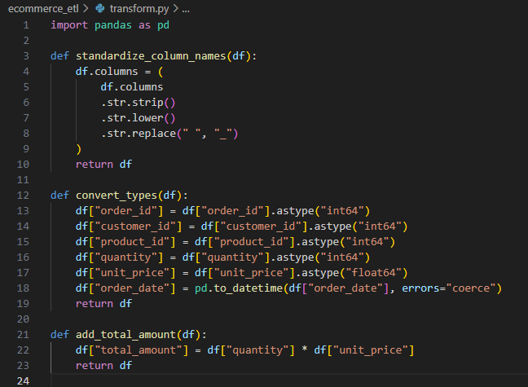
Transform.py

Slide 8
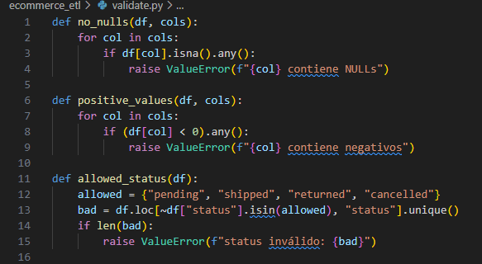
Validate.py

Slide 9
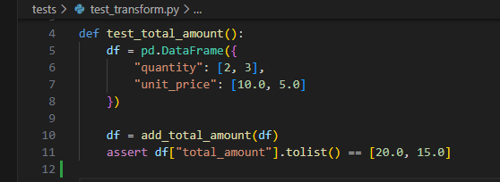
Test_transform.py

Slide 10

Etl.log

Slide 11
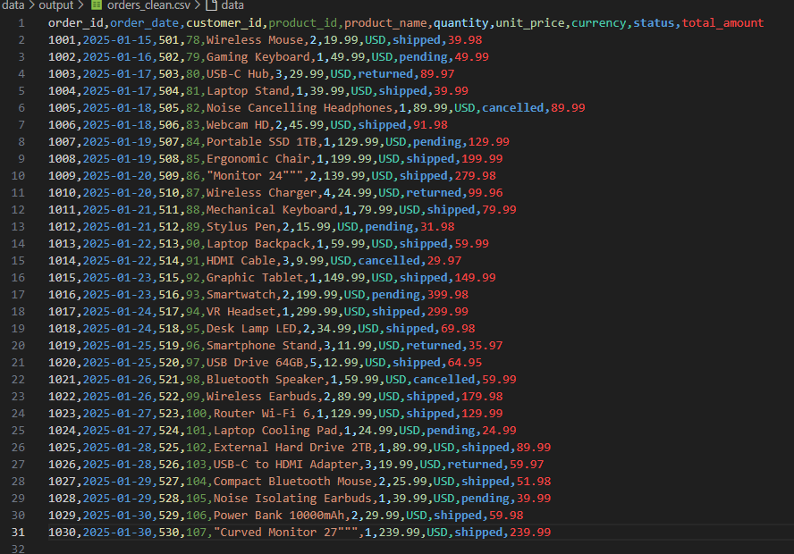
Data Cleaned Output

